Slide 1
MCDA 5550 - Web App Development Chapter 05: A Menu-Driven App to Monitor Important Indicators
Instructor: Dinesh kg

Slide 2
Read and modify code
One of important skills as a programmer
You will modify the expense tracker app to create a new app

Slide 3
Expense Tracker App Design (Overview)
Keep track of expense records of users
User profiles
Add/delete expense records
Feedback

Slide 4
Expense Tracker App Design(profile)
Password protection
Ability to change the password
Storing information (including password) locally on the device
Making sure that the user has agreed to terms and conditions or disclaimers
Acquiring basic information from the user
Editing the basic information

Slide 5
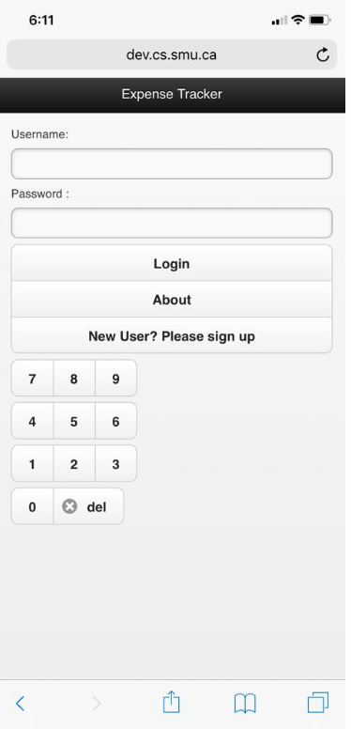
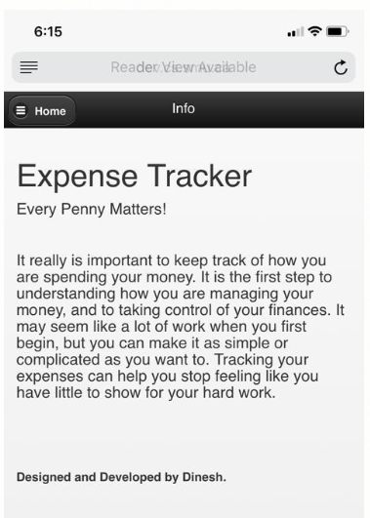
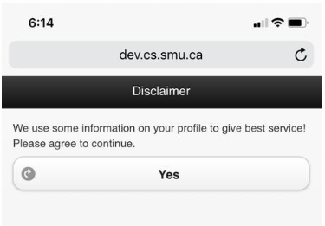

Slide 6
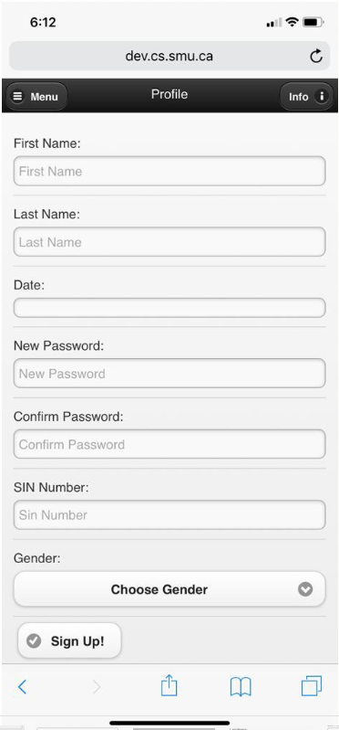
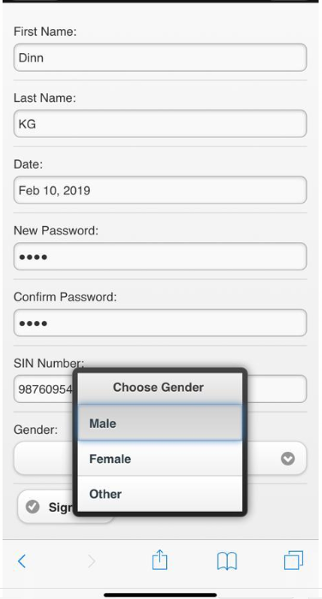
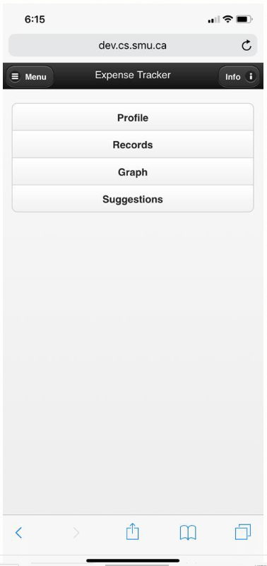

Slide 7
Expense Tracker App (records)
Creating new entries
Editing existing entries
Deleting individual entries
Editing individual entries
Clearing the entire history

Slide 8
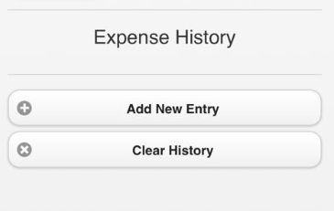
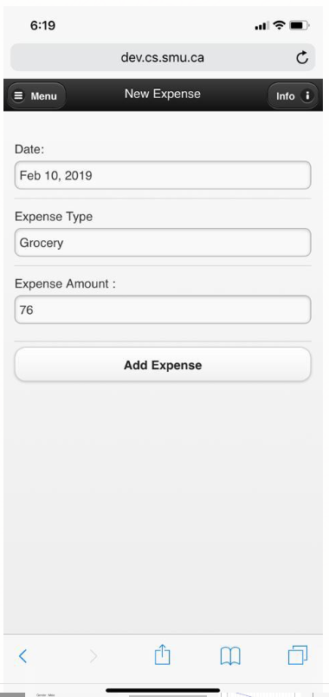
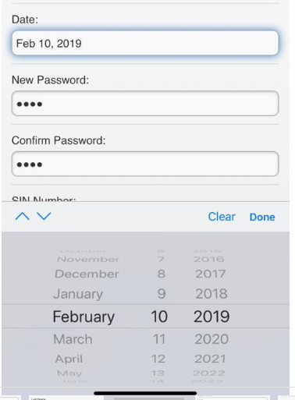

Slide 9
Expense Tracker App (feedback)
Tabular view of the history
Graphical view of the history
Advice using graphical widgets

Slide 10
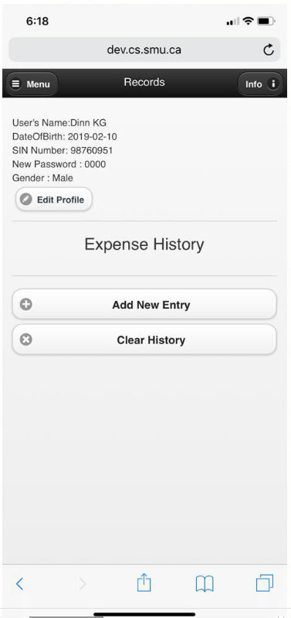
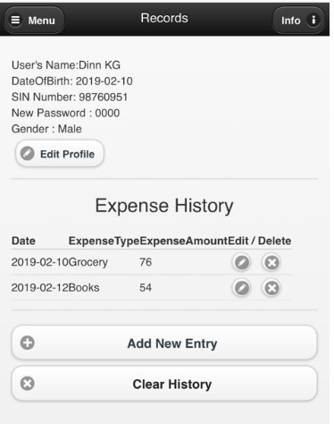

Slide 11
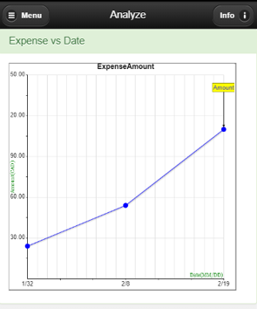
Graph

Slide 12
10 different data role “pages”
Login page (id = “pageHome”)
Sign up page (id = “pageSignup”)
About/info page (id=“pageAbout”)
Disclaimer page (id=“legalNotice”)
Profile (id="pageUserInfo)
Menu page (id="pageMenu“)
Record page (id="pageRecords“)
New record page (id="pageNewRecordForm“)
Graph/Analysis page (id="pageGraph “)
Suggestion page (id="pageAdvice “)

Slide 13
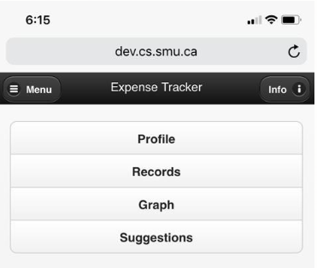
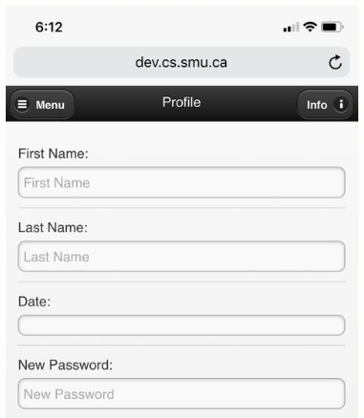
Moving around Pages
These id’s are used to move between different pages within the app:
/ExpenseTracker/#pageMenu /ExpenseTracker/#pageSignup

Slide 14
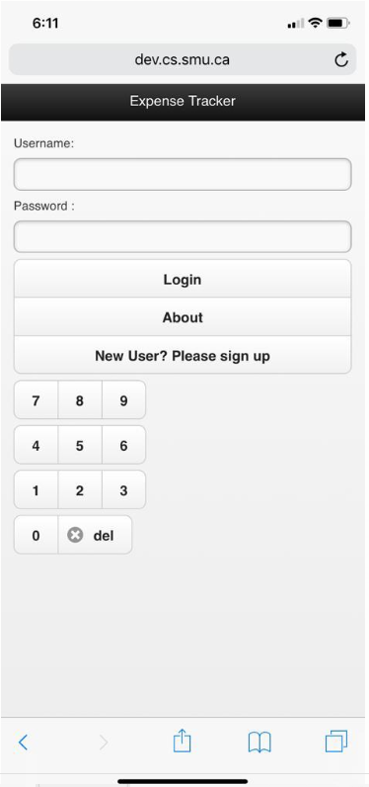
1. Login Page
What elements?

Slide 15
<!-- Start of first page -->
<div data-role="page" id="pageHome">
<div data-role="header">
<h1>Expense Tracker</h1>
</div>
<div data-role="content">
Username:
<input type="text" id="username">
Password :
<input type="password" id="passcode">
<div data-role="controlgroup" id="numKeyPad">
<a data-role="button" id="btnEnter" onclick="redirectPage()">Login</a>
<a href="#pageAbout" data-role="button">About</a>
<a href="#pageSignup" data-role="button">New User? Please sign up</a>
</div>
<div data-role="controlgroup" data-type="horizontal">
<a data-role="button" onclick="addValueToPassword(7)">7</a>
<a data-role="button" onclick="addValueToPassword(8)">8</a>
<a data-role="button" onclick="addValueToPassword(9)">9</a>
</div>
<div data-role="controlgroup" data-type="horizontal">
<a data-role="button" onclick="addValueToPassword(4)">4</a>
<a data-role="button" onclick="addValueToPassword(5)">5</a>
<a data-role="button" onclick="addValueToPassword(6)">6</a>
</div>
<div data-role="controlgroup" data-type="horizontal">
<a data-role="button" onclick="addValueToPassword(1)">1</a>
<a data-role="button" onclick="addValueToPassword(2)">2</a>
<a data-role="button" onclick="addValueToPassword(3)">3</a>
</div>
<div data-role="controlgroup" data-type="horizontal">
<a data-role="button" onclick="addValueToPassword(0)">0</a>
<a data-role="button" onclick="addValueToPassword('bksp')" data-icon="delete">del</a>
</div>
</div>
</div>

Slide 16
Password
<input type="password“ …
Whatever is entered by the user will not be displayed
Only dots will appear as user types the text in this box

Slide 17
Cont’d…
controlgroup to group elements (anchor elements in the above example)
a tag’s data-role to button
<div data-role="controlgroup" id="numKeyPad">
<a data-role="button" id="btnEnter" onclick="redirectPage()">Login</a>
<a href="#pageAbout" data-role="button">About</a>
<a href="#pageSignup" data-role="button">New User? Please sign up</a>
</div>

Slide 18
Cont’d…
data-type to “horizontal” to make positioned child elements in a single horizontal role
Each keypad triggers addValueToPassword() function
<div data-role="controlgroup" data-type="horizontal">
<a data-role="button" onclick="addValueToPassword(7)">7</a>
<a data-role="button" onclick="addValueToPassword(8)">8</a>
<a data-role="button" onclick="addValueToPassword(9)">9</a>
</div>

Slide 19
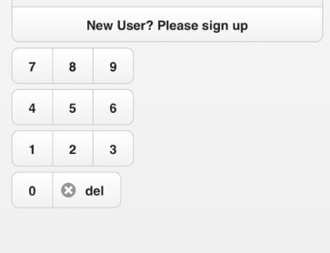
Cont’d…
<a data-role="button" onclick = "addValueToPassword(‘bksp’)" data-icon="delete">del</a>

Slide 20
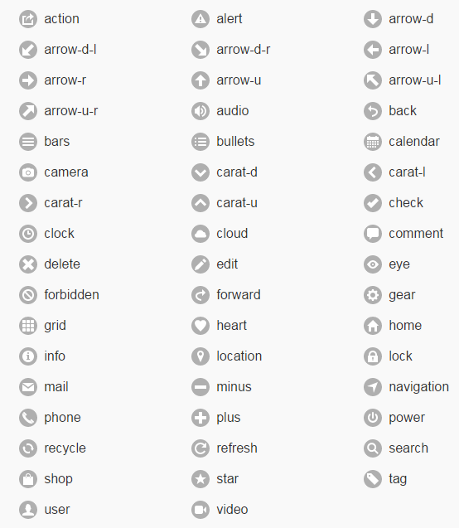
jQuery mobile icons
http://demos.jquerymobile.com/1.4.5/icons/
data-icon = “…”
If you’re running jQuery mobile (ver 1.3) on your own server, you may need to download icon files as well!!
See: http://jquerymobile.com/resources/download/jquery.mobile-1.3.1.zip

Slide 21
/* Adds given text value to the password text
* field
*/
function addValueToPassword(button) {
var currVal = $("#passcode").val();
if (button === "bksp") {
$("#passcode").val(currVal.substring(0, currVal.length - 1));
} else {
$("#passcode").val(currVal.concat(button));
}
}
string.substring(start,end)
extracts a part of the string from [start, end)
string.concat(string2)
Same as string+string2

Slide 22
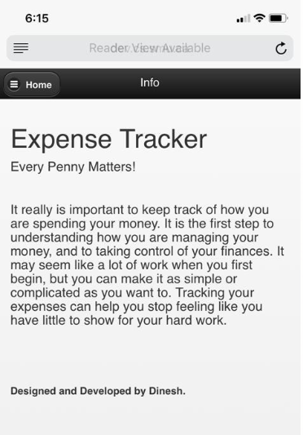
2. About/Info page

Slide 23
<!--About Page -->
<div data-role="page" id="pageAbout">
<div data-role="header">
<a href="#pageHome" data-role="button" data-icon="bars" data-iconpos="left">Home</a>
<h1>Info</h1>
</div>
<div data-role="content">
<h1>Expense Tracker</h1>
<h4>Every Penny Matters!</h4><br>
<h4>It really is important to keep track of how you are spending your money.
It is the first step to understanding how you are managing your money, and to taking control of your finances.
It may seem like a lot of work when you first begin, but you can make it as simple or complicated as you want to. Tracking your expenses can help you stop feeling like you have little to show for your hard work.
</h4><br><br><br>
<h5><b>Designed and Developed by Dinesh.</b></h5>
</div>
</div>

Slide 24
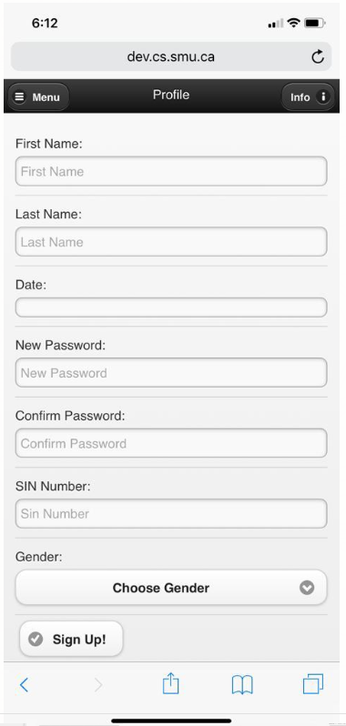
3. Sign up page

Slide 25
<!--Sign Up Page/Form -->
<!--Header of the Page -->
<div data-role="page" id="pageSignup">
<div data-role="header">
<a href="#pageHome" data-role="button" data-icon="bars" data-iconpos="left" data-inline="true">Menu</a>
<a href="#pageAbout" data-role="button" data-icon="info" data-iconpos="right" data-inline="true">Info</a>
<h1>Profile</h1>
</div>
<!-- Content for the User Information -->
<div data-role="content">
<form id="frmSignForm" action="">
<div data-role="fieldcontain">
<label for="signupFirstName">First Name: </label>
<input type="text" placeholder="First Name" name="signupFirstName" data-mini="false" id="signupFirstName" value="" required>
</div>
<div data-role="fieldcontain">
<label for="signupLastName">Last Name: </label>
<input type="text" placeholder="Last Name" name="signupLastName" data-mini="false" id="signupLastName" value="" required>
</div>
<div data-role="fieldcontain">
<label for="dateOfBirth">Date: </label>
<input type="date" name="dateOfBirth" data-mini="false" id="dateOfBirth" value="">
</div>
<div data-role="fieldcontain">
<label for="addPassword">New Password: </label>
<input type="password" placeholder="New Password" name="addPassword" data-mini="false" id="addPassword" value="" required>
</div>
<div data-role="fieldcontain">
<label for="confirmPassword">Confirm Password: </label>
<input type="password" placeholder="Confirm Password" name="confirmPassword" data-mini="false" id="confirmPassword" value="" required>
</div>
<div data-role="fieldcontain">
<label for="signupsinNumber">SIN Number: </label>
<input type="text" placeholder="Sin Number" name="signupsinNumber" data-mini="false" id="signupsinNumber" value="" required>
</div>
<div data-role="fieldcontain">
<label for="signgenderType" class="select">Gender: </label>
<select name="signgenderType" id="signgenderType" data-mini="false"
data-native-menu="false" required>
<option>Choose Gender</option>
<option value="Male">Male</option>
<option value="Female">Female</option>
<option value="Other">Other</option>
</select>
</div>
<input type="submit" id="btnUserAdd" data-icon="check" data-iconpos="left" value="Sign Up!" data-inline="true" onclick="saveSignUpUser()">
</form>
</div>
</div>

Slide 26
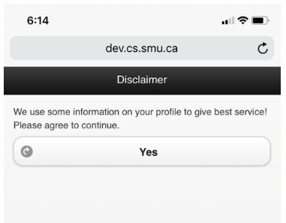
4. Disclaimer page
<!--Disclaimer Page -->
<div data-role="page" id="legalNotice" data-close-btn="none">
<div data-role="header" >
<h1>Disclaimer</h1>
</div>
<div data-role="content">
We use some information on your profile to give best service! Please agree to continue.
<br>
<a href="#pageUserInfo" id="noticeYes" data-role="button" data-icon ="forward" data-mini ="false" onclick="saveDisclaimer()">Yes</a>
</div>
</div>

Slide 27
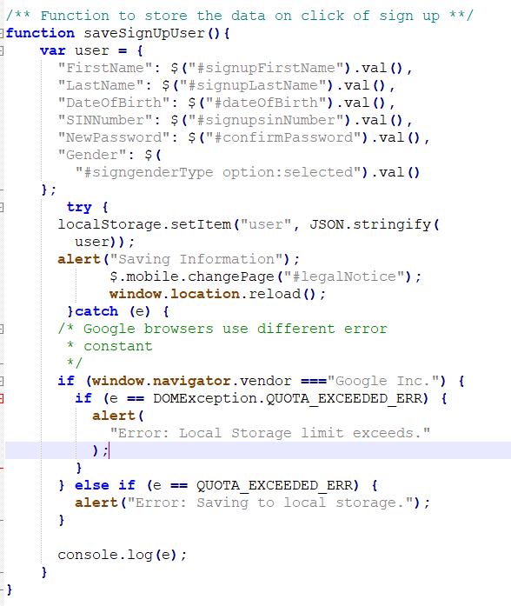
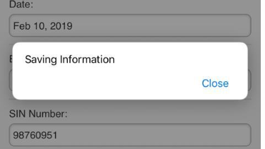
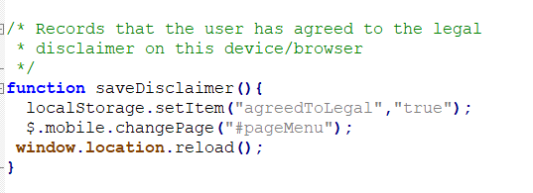

Slide 28
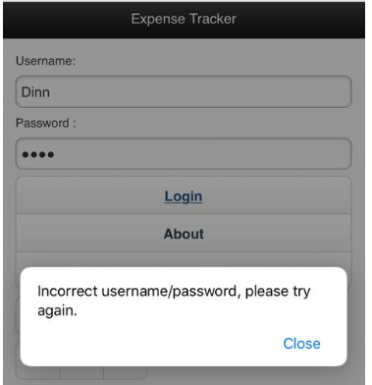
How do we get here?
//if the password matches
if (document.getElementById("passcode").value === password && document.getElementById("username").value === userName )
{
//if not agreed yet
if (localStorage.getItem("agreedToLegal") === null)
{
$("#btnEnter").attr("href","#legalNotice").button();
}
else if (localStorage.getItem("agreedToLegal") === "true")
{
$("#btnEnter").attr("href","#pageMenu").button();
}
}
else {
alert("Incorrect username/password, please try again.");
}

Slide 29
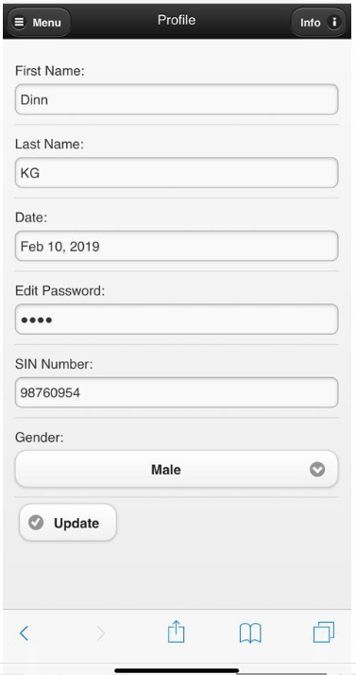
5. Profile
Update button will call a function to save the edited info (which we’ll see it later)

Slide 30
Cont’d…
<!--User Information Page/Form -->
<!--Header of the Page -->
<div data-role="page" id="pageUserInfo">
<div data-role="header">
<a href="#pageMenu" data-role="button" data-icon="bars" data-iconpos="left" data-inline="true">Menu</a>
…………………………………………………………………………………………………………………………………………………………………………………………………………………………………………………………
<input type="submit" id="btnUserUpdate" data-icon="check" data-iconpos="left" value="Update" data-inline="true" onclick="saveUserForm()">
</form>
</div>
</div>
data-inline = “true”
will style the buttons to be the width of their content and float the buttons so they sit on the same line.

Slide 31
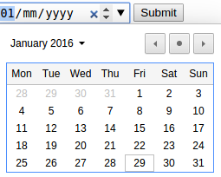
Date
<input type="date" …
used for input fields that should contain a date.
Depending on browser support, a date picker can show up in the input field.
Could have restrictions:
<input type="date" max="1980-01-01">

Slide 32
Select
<select …
Used to create a drop-down list.
The <option> tags define options in the list.
data-mini is used to tell if it should appear smaller on mobile devices (provided by jQM)

Slide 33
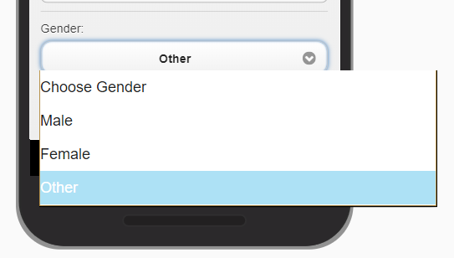
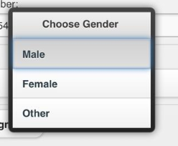
Cont’d…
Setting data-native-menu to “false” uses jMQ look/feel instead of the native selects.
Native drop-down
jMQ drop-down

Slide 34
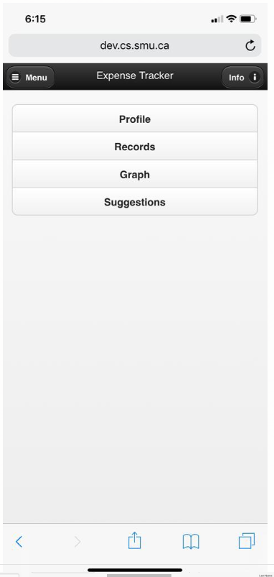
6. Menu

Slide 35
Cont’d…
<!-- Menu page -->
<div data-role="page" id="pageMenu">
<div data-role="header">
<a href="#pageMenu" data-role="button" data-icon="bars" data-iconpos="left" data-inline="true">Menu</a>
<a href="#pageAbout" data-role="button" data-icon="info" data-iconpos="right" data-inline="true">Info</a>
<h1>Expense Tracker</h1>
</div>
<div data-role="content">
<div data-role="controlgroup">
<a href="#pageUserInfo" data-role="button">Profile</a>
<a href="#pageRecords" data-role="button">Records</a>
<a href="#pageGraph" data-role="button">Graph</a>
<a href="#pageAdvice" data-role="button">Suggestions</a>
</div>
</div>
</div>

Slide 36
#
# is used for the anchor within the current page
Jumps to the corresponding ids

Slide 37
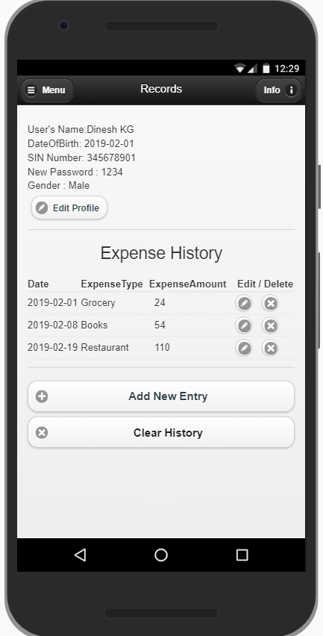
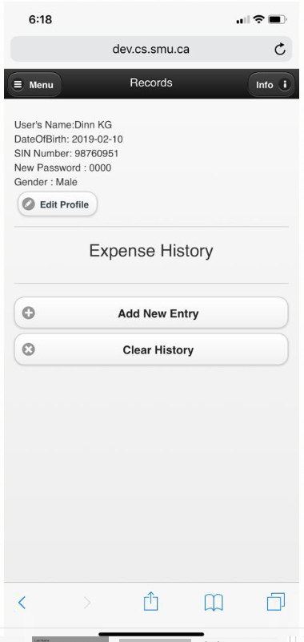
7. Record page

Slide 38
Cont’d…
<!-- Records page -->
<div data-role="page" id="pageRecords">
<div data-role="header">
<a href="#pageMenu" data-role="button" data-icon="bars" data-iconpos="left" data-inline="true">Menu</a>
<a href="#pageAbout" data-role="button" data-icon="info" data-iconpos="right" data-inline="true">Info</a>
<h1>Records</h1>
</div>
<div data-role="content">
<!-- User's Information Section -->
<div data-role="fieldcontain" id="divUserSection">
</div>
<h3 align="center">Expense History</h3>
<div data-role="fieldcontain">
<!-- Records Table -->
<table id="tblRecords" class="ui-responsive table-stroke">
</table>
</div>
<div data-role="fieldcontain">
<a href="#pageNewRecordForm" id="btnAddRecord" data-role="button" data-icon="plus" onclick="AddNewRecord()">Add New Entry</a>
<a href="#" data-role="button" id="btnClearHistory" data-icon="delete" onclick="clearRecordHistory()">Clear History</a>
</div>
</div>
</div>

Slide 39
Clear History
To remove all the stored records
// Removes all record data from localStorage
$("#btnClearHistory").click(function () {
localStorage.removeItem("tbRecords");
listRecords();
alert("All records have been deleted.");
});

Slide 40
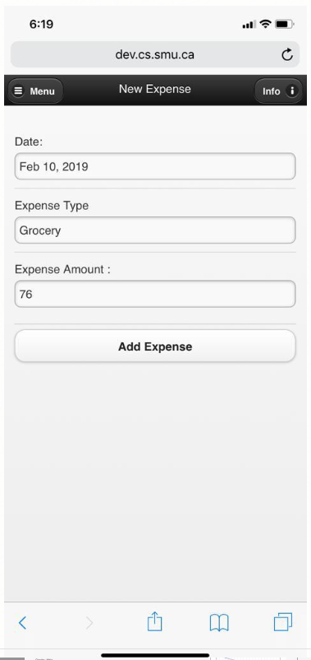
8. New record page

Slide 41
<!-- New Record Form page -->
<div data-role="page" id="pageNewRecordForm">
<div data-role="header">
<a href="#pageMenu" data-role="button" data-icon="bars" data-iconpos="left" data-inline="true">Menu</a>
<a href="#pageAbout" data-role="button" data-icon="info" data-iconpos="right" data-inline="true">Info</a>
<h1>New Expense</h1>
</div>
<div data-role="content">
<form id="frmNewRecordForm" action="">
<div data-role="fieldcontain">
<div data-role="fieldcontain">
<label for="datExpenseDate">Date: </label>
<input type="date" name="datExpenseDate" data-mini="false" id="datExpenseDate" value="">
</div>
<div data-role="fieldcontain">
<label for="txtType"> Expense Type </label>
<input type="text" name="txtType"
data-mini="false" id="txtType" value="">
</div>
<div data-role="fieldcontain">
<label for="txtAmount">Expense Amount : </label>
<input type="number" placeholder="Amount in CAD" name="txtAmount"
data-mini="false" id="txtAmount" value="">
</div>
</div>
<input type="submit" id="btnSubmitRecord" value="" onclick ="checkAddOrEditRecord()">
</form>
</div>
</div>

Slide 42
Cont’d…
/* The value of the Submit Record button is used
* to determine which operation should be
* performed
*/
$("#btnAddRecord").click(function () {
/*.button("refresh") function forces jQuery
* Mobile to refresh the text on the button
*/
$("#btnSubmitRecord").val("Add").button(
"refresh");
});

Slide 43
Cont’d…
function checkAddOrEditRecord() {
var formOperation = $("#btnSubmitRecord").val();
if (formOperation == "Add Expense") {
addRecord();
$.mobile.changePage("#pageRecords");
} else if (formOperation == "Update Expense") {
editRecord($("#btnSubmitRecord").attr("indexToEdit"));
$.mobile.changePage("#pageRecords");
$("#btnSubmitRecord").removeAttr("indexToEdit");
}
/*Must return false, or else submitting form
* results in reloading the page
*/
return false;
}

Slide 44
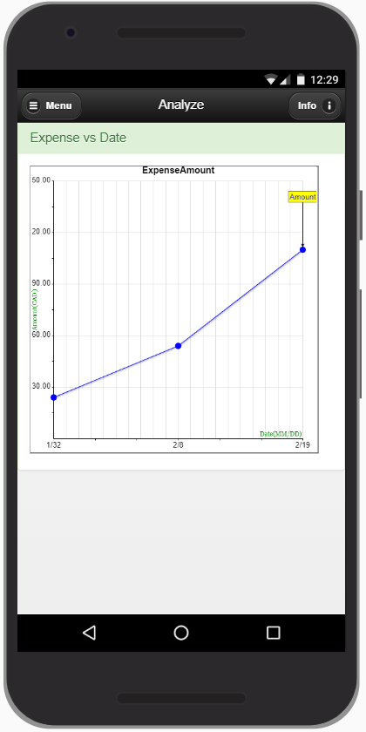
9. Graph/Analyze page

Slide 45
Cont’d…
<!--Graph Page -->
<div data-role="page" id="pageGraph" class="test">
<div data-role="header">
<a href="#pageMenu" data-role="button" data-icon="bars" data-iconpos="left" data-inline="true">Menu</a>
<a href="#pageAbout" data-role="button" data-icon="info" data-iconpos="right" data-inline="true">Info</a>
<h1>Analyze</h1>
</div>
<div class="panel panel-success">
<div class="panel-heading">
<h3 class="panel-title">Expense vs Date</h3>
</div>
<div class="panel-body">
<canvas id="GraphCanvas" width="500" height="500" style="border:1px solid #000000;">
</canvas>
</div>
</div>
</div>

Slide 46
bootstrap.css
A front-end framework for faster and easier web development
HTML and CSS based design templates for typography, forms, buttons, tables, navigation, modals, image carousels and many other, as well as optional JavaScript plugins
Ability to easily create responsive designs

Slide 47
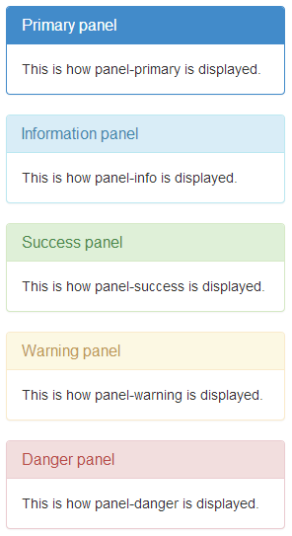
<div class="panel panel-primary">
<div class="panel-heading">
<h3 class="panel-title">Primary panel</h3>
</div>
<div class="panel-body">
This is how panel-primary is displayed.
</div>
</div>
<div class="panel panel-info">
<div class="panel-heading">
<h3 class="panel-title">Information panel</h3>
</div>
<div class="panel-body">
This is how panel-info is displayed.
</div>
</div>
<div class="panel panel-success">
<div class="panel-heading">
<h3 class="panel-title">Success panel</h3>
</div>
<div class="panel-body">
This is how panel-success is displayed.
</div>
</div>
<div class="panel panel-warning">
<div class="panel-heading">
<h3 class="panel-title">Warning panel</h3>
</div>
<div class="panel-body">
This is how panel-warning is displayed.
</div>
</div>
<div class="panel panel-danger">
<div class="panel-heading">
<h3 class="panel-title">Danger panel</h3>
</div>
<div class="panel-body">
This is how panel-danger is displayed.
</div>
</div>

Slide 48
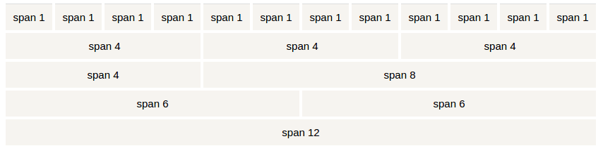
Bootstrap Grid Layout
Bootstrap's grid system allows up to 12 columns across the page
xs (for phones)
sm (for tablets)
md (for desktops)
lg (for larger desktops)

Slide 49
Bootstrap grids
Try it yourself!
http://www.w3schools.com/bootstrap/tryit.asp?filename=trybs_grid_ex1&stacked=h
<div class="col-sm-4" style="background-color:lavender;">.col-sm-4</div>
<div class="col-sm-4" style="background-color:lavenderblush;">.col-sm-4</div>
<div class="col-sm-4" style="background-color:lavender;">.col-sm-4</div>

Slide 50
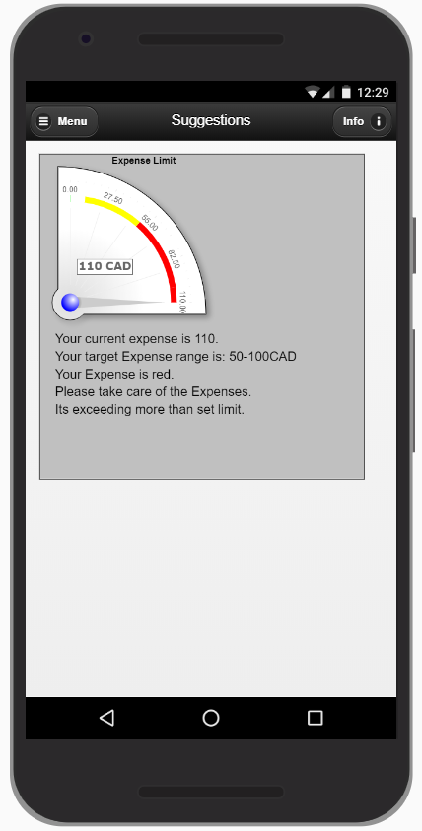
10. Advice page

Slide 51
Cont’d…
<!--Suggestion Page -->
<div data-role="page" id="pageAdvice">
<div data-role="header">
<a href="#pageMenu" data-role="button" data-icon="bars"
data-iconpos="left" data-inline="true">Menu</a>
<a href="#pageAbout" data-role="button" data-icon="info"
data-iconpos="right" data-inline="true">Info</a>
<h1>Suggestions</h1>
</div>
<div data-role="content">
<canvas id="AdviceCanvas" width="550" height="550" style="border:1px solid #000000;">
</canvas>
</div>
</div>

Slide 52
Include js files
This is for Project1!
<!--Custom Javascript/Jquery -->
<script src="RGraph.common.core.js"></script>
<script src="RGraph.common.effects.js"></script>
<script src="RGraph.line.js"></script>
<script src="RGraph.cornergauge.js"></script>
<script src="RGraph.hprogress.js"></script>

Slide 53
Activities (Assignment3)
Learning Tracker App Only front end is required Model it after the expense tracker app You could start from scratch but easier to modify the expense tracker app Just a skeleton! (No js yet!) Due Date - June 10, 11.59 pm

Slide 54
(recap) 10 different data role “pages”
Login page (id = “pageHome”)
Sign up page (id = “pageSignup”)
About/info page (id=“pageAbout”)
Disclaimer page (id=“legalNotice”)
Profile (id="pageUserInfo”)
Menu page (id="pageMenu“)
Record page (id="pageRecords“)
New record page (id="pageNewRecordForm“)
Graph/Analysis page (id="pageGraph “)
Suggestion page (id="pageAdvice “)

Slide 55
Recommended links
<!-- CSS -->
<link rel="stylesheet" href="http://code.jquery.com/mobile/1.3.1/jquery.mobile-1.3.1.min.css">
<link rel="stylesheet" href="https://maxcdn.bootstrapcdn.com/bootstrap/3.3.6/css/bootstrap.min.css">
<!-- JQ -->
<script src="https://ajax.googleapis.com/ajax/libs/jquery/1.9.1/jquery.min.js"></script>
<script>
//for bypassing the chrome error
$(document).bind('mobileinit', function () {
$.mobile.pushStateEnabled = false;
});
</script>
<!-- JQM -->
<script src="http://code.jquery.com/mobile/1.3.1/jquery.mobile-1.3.1.min.js"></script>

Slide 56
Notes
You do NOT need to implement javascript just yet (you will later)!
For your Project 1
The grader will look at each data-role page:
e.g.)
index.html#pageMenu
index.html#pageUserInfo
etc...

Slide 57
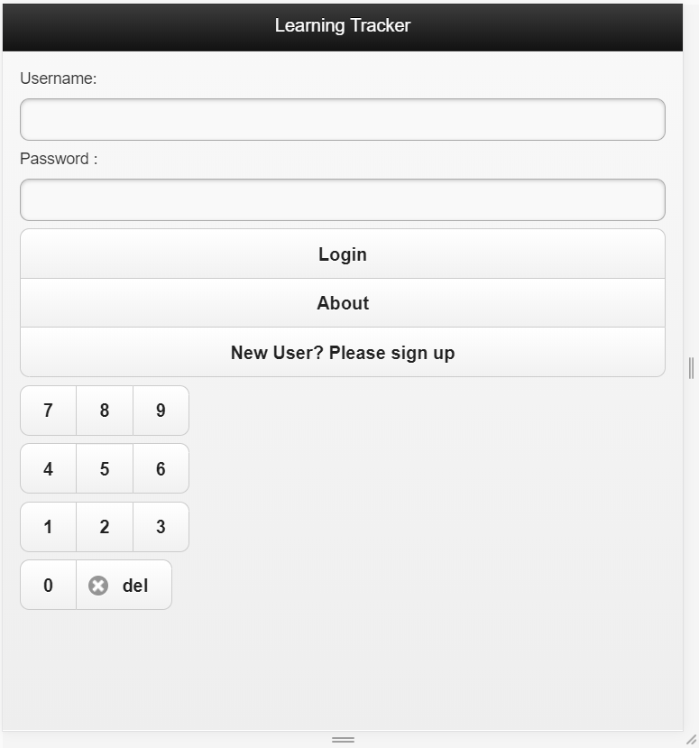
#pageHome

Slide 58
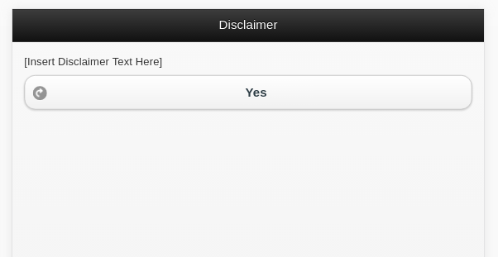
#legalNotice

Slide 59
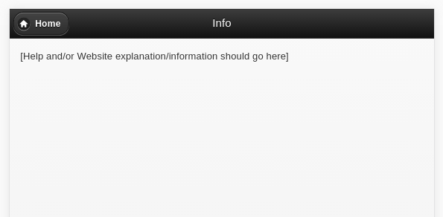
#pageAbout

Slide 60
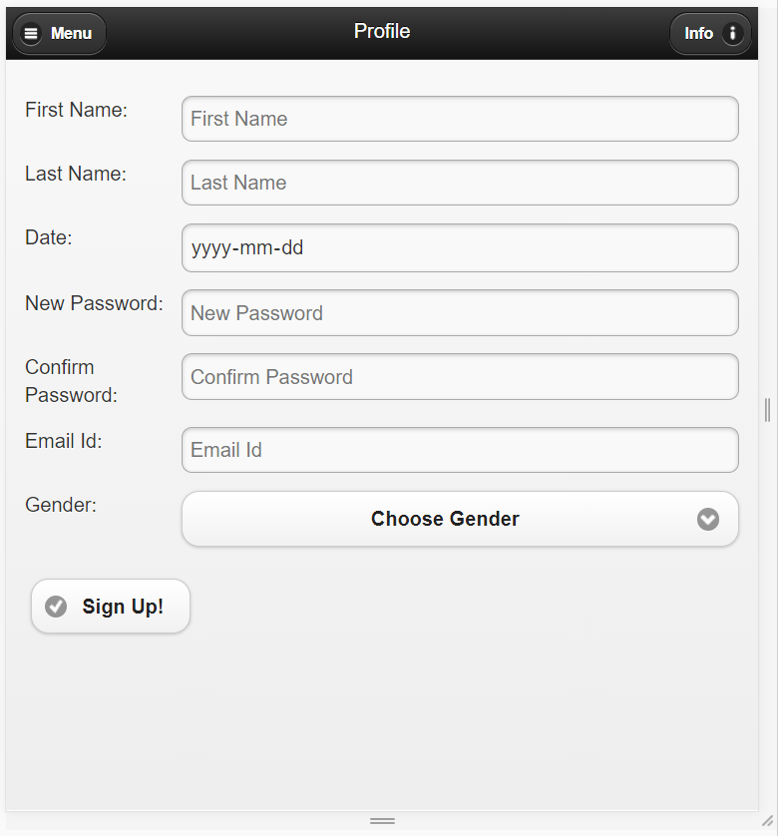
#pageSignup

Slide 61
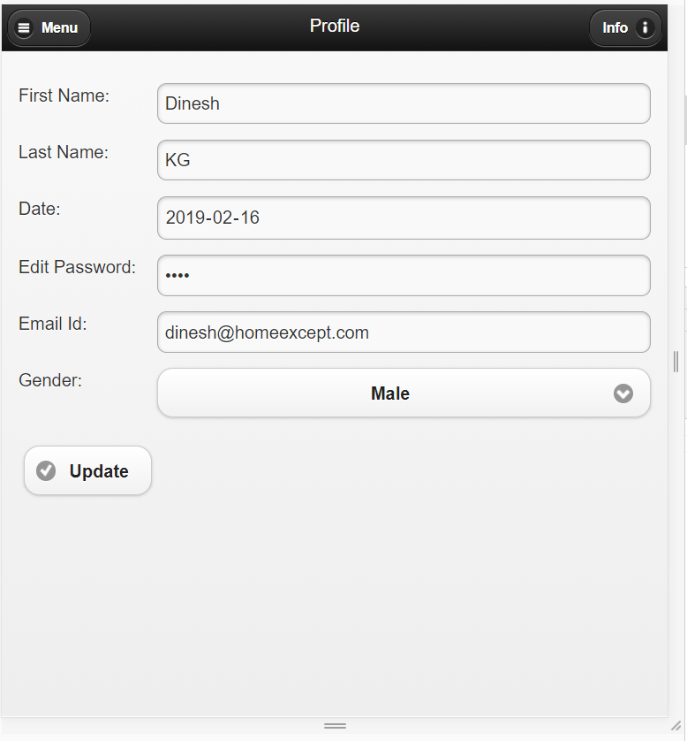
#pageUserInfo

Slide 62
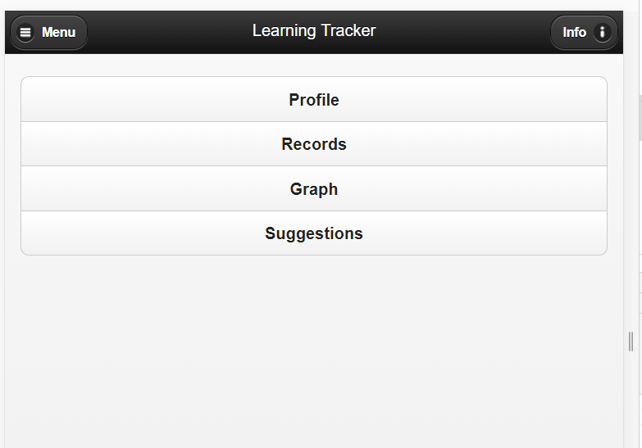
#pageMenu

Slide 63
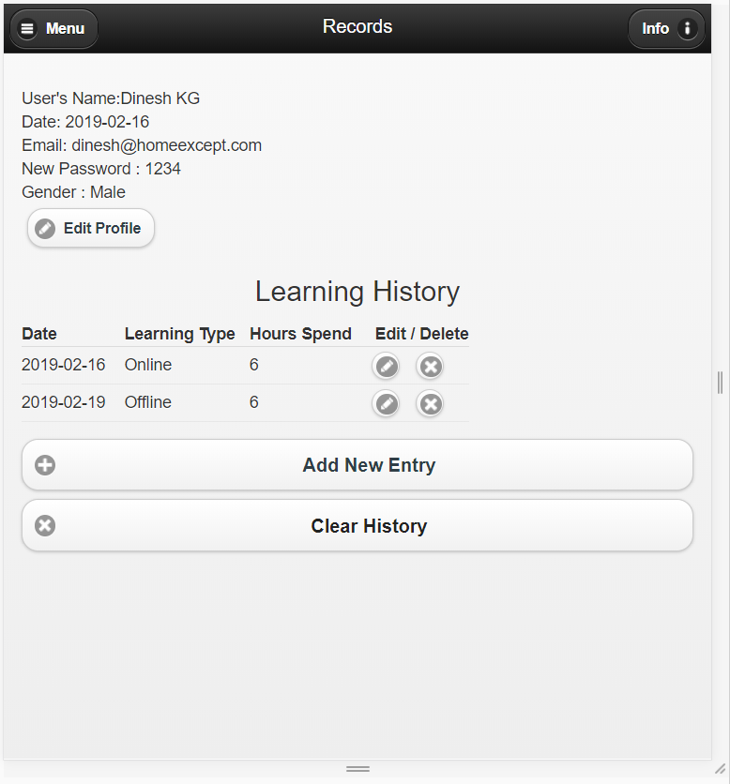
#pageRecords

Slide 64
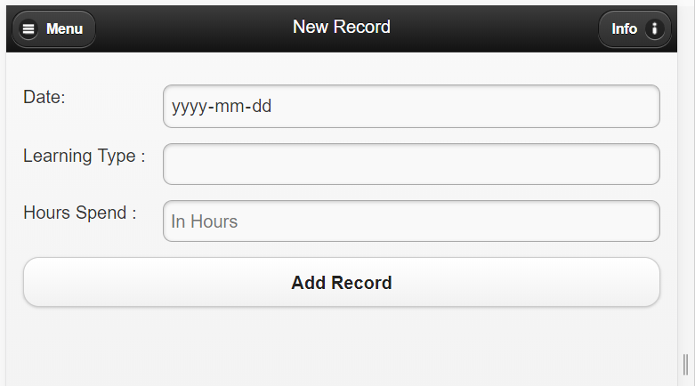
#pageNewRecordForm

Slide 65
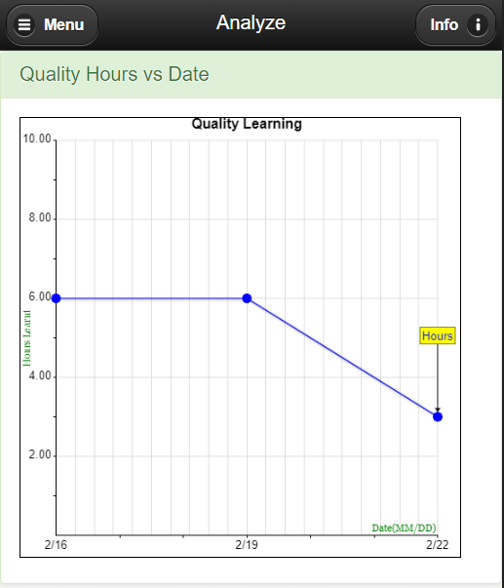
#pageGraph
Don’t need a graphic part yet (just blank is fine)

Slide 66
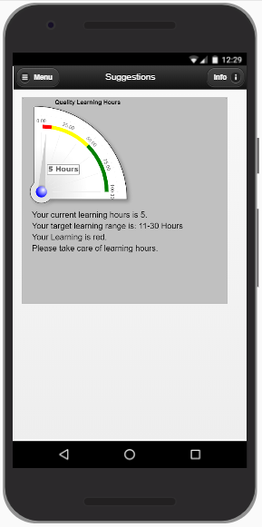
#pageAdvice
Don’t need a graphic part yet (just blank is fine)

